Slide 1

Tier 6: Pollinator Survey
Compiled by Jai Holt for the Bee Informed Partnership

Slide 2
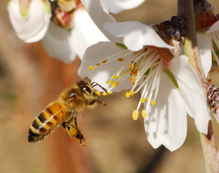
Introduction
Survey honey bee brokers about colony rentals for California almonds
Objective:
Indirectly measure the health of the honey bee industry
Add to existing surveys by including brokers outside California, colony grade, shortage etc.
Methods:
Phone interviews with brokers
Finding:
Colony rental price is rising but at a slower rate
Colony grade may play a role in the true cost of renting
Image from http://www.universityofcalifornia.edu/news/article/28920
Notes:
California State Beekeepers Association survey is the most similar survey already available. It tracks the rental price of colonies for several crops including almonds.

Slide 3
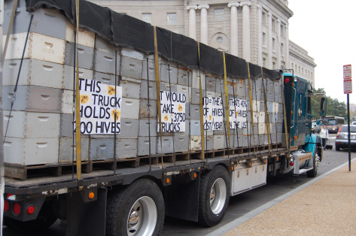
Methods
Bee brokers contacted by phone yearly from 2010-2013
Asked 20 questions about California almond placements
Rental cost (high, low, average)
Colonies placed (total and per acre)
Shortages
Colony grade
http://inspirationsandexplorations.com/2012/11/01/how-i-grew-to-love-bees-and-why-they-matter-to-everyone-who-eats/
Notes:
Bee brokers contacted post almond bloom.
Full lis of survey questions available upon request
Shortage is the number of colonies that the broker was contracted to provide, which his/her beekeepers were unable to supply

Slide 4
Results
Respondents
2010- 23
2011- 23
2012- 16
2013- 20
This analysis focuses on 13 brokers who responded in all 4 years.
The subsample represents approximately 33-43% of the total number of bee brokers.
Notes:
Some respondents lost due to retirement, lost contact information, etc. Most people contacted are eager to participate.
Estimated to be 30-40 bee brokers in the industry

Slide 5
Year | Average | Min | Max
2010 | $137.77 | $60.00 | $180.00
2011 | $152.80 | $110.00 | $177.00
2012 | $154.16 | $135.00 | $177.00
2013 | $154.60 | $95.00 | $200.00
Notes:
As, an economist focused on price and what causes price changes
From the subsample of honey bee brokers, we find that the average colony rental price is rising but a decreasing rate compared with the sharp rise we saw in

Slide 6

What drives rental costs?
Direct cost drivers
Demand for colonies
Supply of colonies
Quantity
Quality
Indirect cost drivers
Cost of outputs- almond price
Cost of inputs
Fuel costs
Cost of bee treatments
Opportunity cost
Cost of the next best alternative- honey production (Rucker et al.)
Notes:
Focus on supply of colonies. Don’t have time to consider honey production in this presentation but it is worth considering

Slide 7
Demand
Almond Acreage data from USDA NASS "2013 California Almond Forecast"
Notes:
Almond bearing acreage as documented by the USDA National Statistics Service has been rising steadily. The rental price of colonies is leveling off despite this rise in colony rentals

Slide 8
Supply
Notes:
Average number of colonies place per acre stays around 2 over the survey period
Supply maybe lower than desired because of colony loses and disease

Slide 9
Supply
Notes:
The survey asks bee brokers “How many colonies, that were committed for pollination, were you and/or those beekeepers you broker for short?”
By summing these the number supplied and the number short we get a rough sense of the colonies demanded.

Slide 10
Supply
Winter loss rates from “A national survey of managed honey bee 2012-2013 annual colony losses in the USA: results from the Bee Informed Partnership” Steinhauer et al.

Slide 11
Supply

Slide 12
Frame weighted average = (average colony price/ average colony grade) *10

Slide 14
Conclusions
Colony rental price for almonds continues to rise but at a slowing rate
Colony grade maybe useful for determining the true cost of colony rental

Slide 15
Thanks you
Any Questions?

Slide 16
How many colonies did you place in almond orchards this year?
How many colonies did you place in almonds last year?
Given an unlimited supply, how many colonies could you have placed in almond orchards this year?
If an additional almond orchard with 100 acres needed bees from you this past season, would you have been able to supply those bees?
What % of the colonies that you placed in almonds were “field run”?
What was the average number of colonies you placed per acre?
What was the highest number of colonies you placed per acre?
What was the lowest number of colonies you placed per acre?
What was the average number of colonies you placed per acre last year?
How many different beekeepers (including yourself) did you place colonies for this year?
How many different almond growers did you place colonies for this year?
How many beekeepers that you broker for (including yourself) had difficulty meeting the number of colonies they committed for pollination?
How many colonies, that were committed for pollination, were you and/or those beekeepers you broker for short?
What was the average grade of the colonies you placed?
What was the average price you received per placed colony?
What was the lowest price received?
What was the highest price received?
What percentage of the hives that you broker for are managed year round in California exclusively?
What percentage of the almonds growers that you supplied with bees this year, did you supply bees to last year as well?
What percentage of beekeepers that you brokered for did you broker for last year as well?

